Slide 1





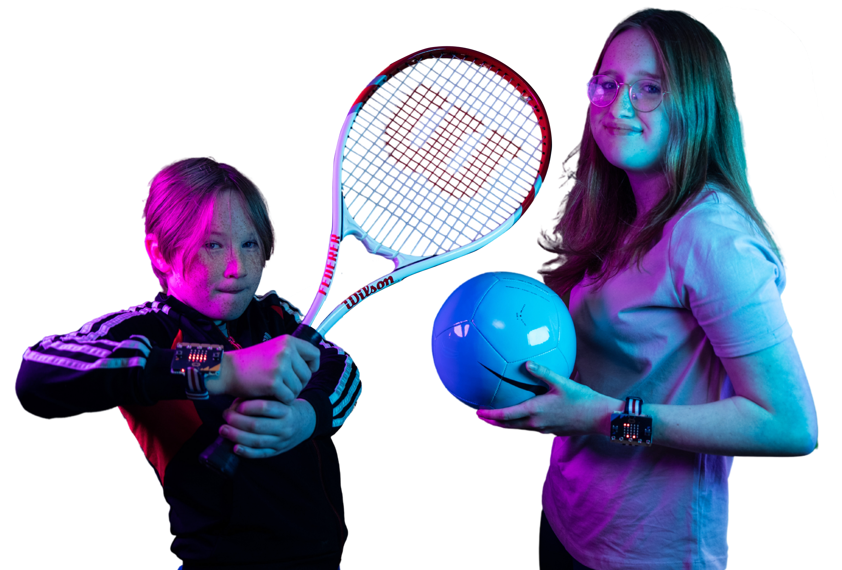


Cold
Feet
CSEdWeek coding activity
info@digitall.charity } @digitallcharity. } Charitable Incorporated Organisation No 1198086

Slide 2




Cold
Feet
CSEdWeek coding activity
Teacher Survey
Pupil Survey and Game
Notes:
1 X £100 Amazon gift voucher available to win for each of the digit<all> CSEdWeek activities (enviroMe,cold feet, tackle coding). Complete a teacher feedback form to be eligible to win. Each pupil feedback form completed for a school will increase the school’s chance of winning by 1.
E.g. if a teacher completes the form, and 10 students from the same school complete a form, the school will be entered into the prize draw 11 times.

Slide 3
Why Don’t Penguin’s Feet Freeze?
There’s some new research that has found out why penguin’s feet don’t freeze.
They can control their blood flow by changing the diameter of their blood vessels.
This means that when it is cold, the flow of blood is reduced and they hold onto the heat. Clever penguins!
Find out more here: https://www.penguinsinternational.org/2019/12/22/cold-feet-why-dont-penguins-feet-freeze/

Slide 4
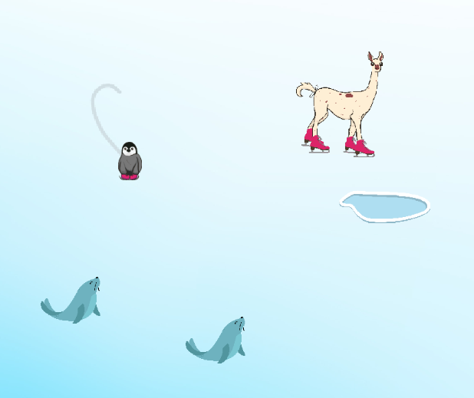
Cold Feet Game Overview
Get access to the game here: www.tiny.cc/coldfeetgame
You find yourself on the Antarctic ice but you’re not alone…
There are seals and Fifi the llama who will knock you off course.
As you skate around the ice you’ll make beautiful marks in the ice to create your own ice art.
Find out more here: www.tiny.cc/coldfeetintro

Slide 5
Tinker Time
Can you change the speed of the penguin?
Can you find out how to make Fifi the llama go a little slower?
Can you find out what the code does when you collide into a seal or Fifi?
Here’s a short guide: www.tiny.cc/coldfeettinker

Slide 6
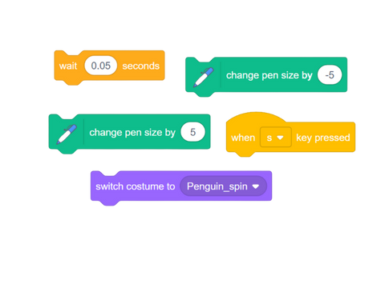

Paint With A Spin
Can you combine these blocks so that the penguin does a pirouette when you press the ‘s’ key?
You’ll need to make the pen size go higher to draw a circle or bigger line and then take the pen size back again.
Don’t forget to change the costume to Penguin_spin as well.
Here’s a quick guide: www.tiny.cc/coldfeetspin

Slide 7

Get Arty
Get arty with a friend by getting them to open up your games side-by-side
Decide on what it is you are going to draw, and after a 5-4-3-2-1 countdown get drawing on the ice.
Press space bar when you have finished
Compare both of your artwork – what do you think?
Here’s some ideas of what to draw:
A snowman
A tree
A decoration

Slide 8
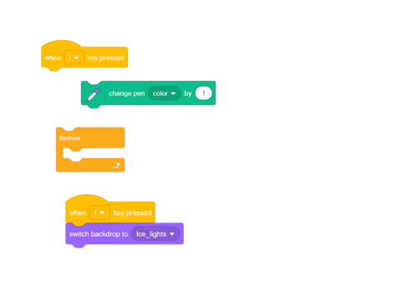
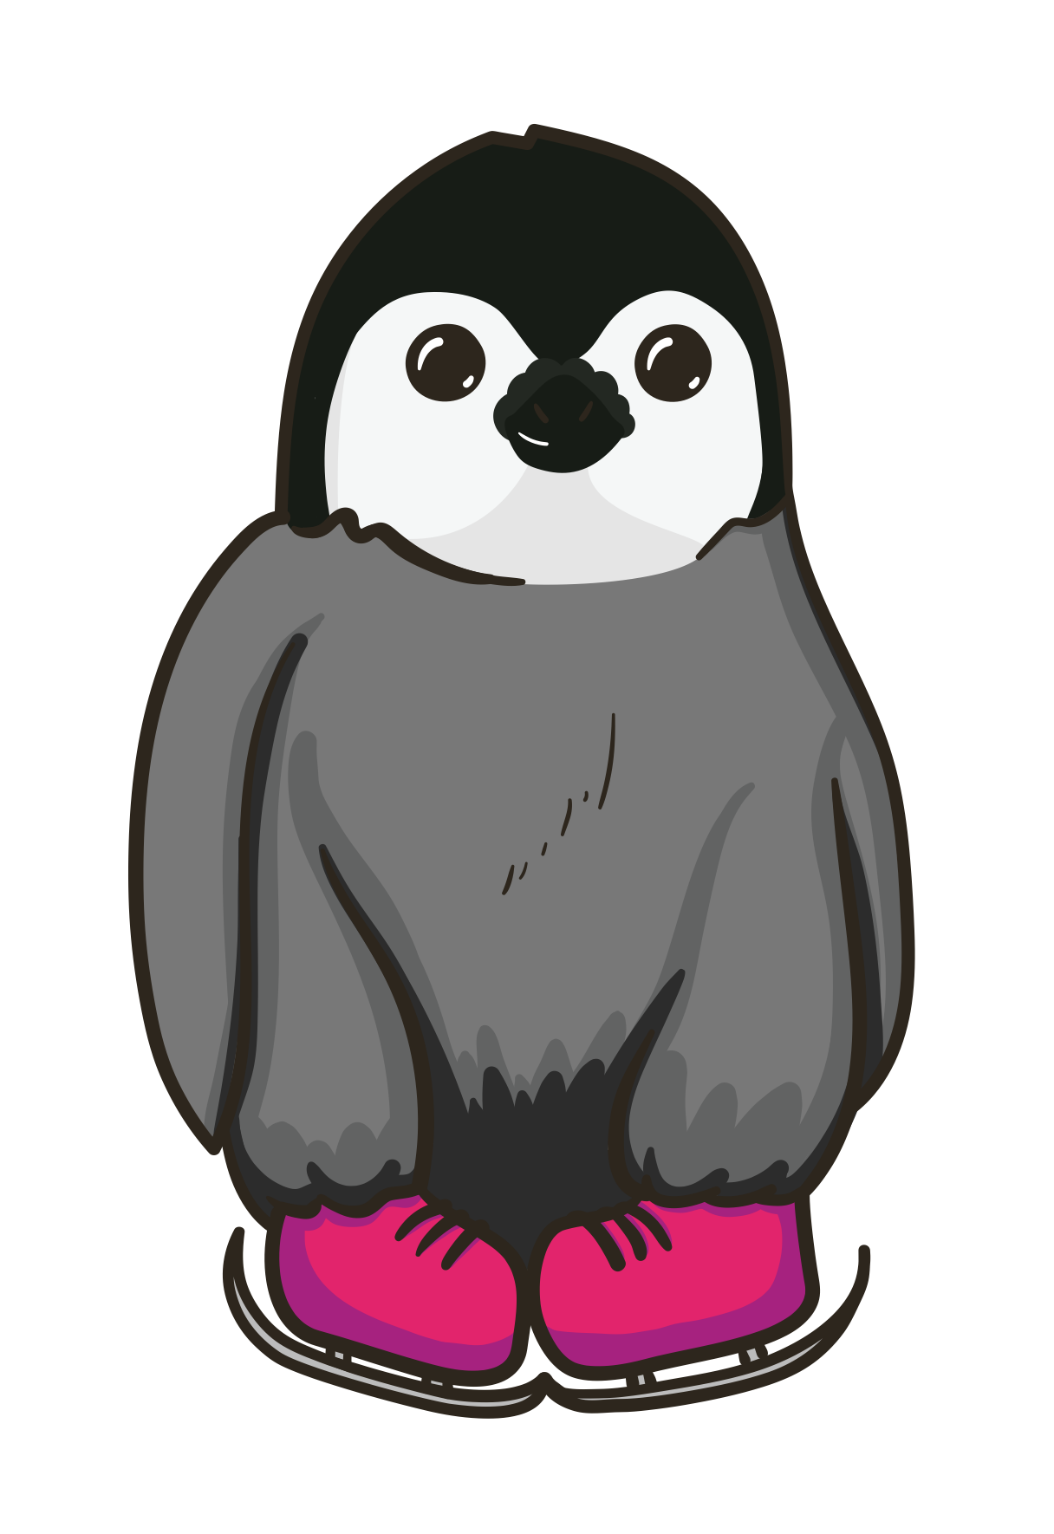
Northern Lights
The real name for the Northern Lights in the Antarctica are the Auroras.
Using these blocks can you get the background to light up and change the skate line to be rainbow coloured?
Maybe use the ‘t’ key to turn on the lights!
Here’s a short guide: www.tiny.cc/coldfeetlights

Slide 9
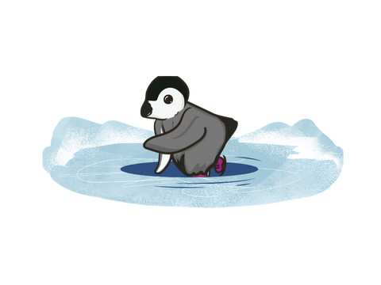
Fall Into The Lake
Can you get the penguin to fall into the lake if it touches it?
This one isn’t easy, so you might need this quick guide to help www.tiny.cc/coldfeetlake

